Slide 1

MCA Final Year Project (Review II)
Diet Recommender system using machine leaning
Submitted to the Presidency University, Bengaluru in partial fulfillment for the award of the degree of Master of Computer Applications(MCA)
Project Number : 213
Under the supervision of
Mr. Sakthi S
Asst. Prof, Department of SCSE
School of Computer Science and Engineering
Name | Roll Number
Shivashat Patil | 20232MCA0218
1

Slide 2
Content
Problem Statement
Literature Survey
Tools and Technologies to be used
Github Link
Timeline of the Project
References

Slide 3
Problem Statement
1. Rising Health Issues: Poor nutrition leads to diseases, and generic diets fail. AI-based recommendations provide personalized meal plans.
2. Personalized Nutrition: Traditional diets ignore health needs. Machine learning offers customized meal plans for better adherence and results.
3. Smart Diet Assistance: Unhealthy eating and generic plans cause deficiencies. AI ensures balanced, personalized nutrition.
4. AI-Powered Meal Plans: Standard diets lack adaptability. Machine learning tailors nutrition to individual needs for better health.

Slide 4
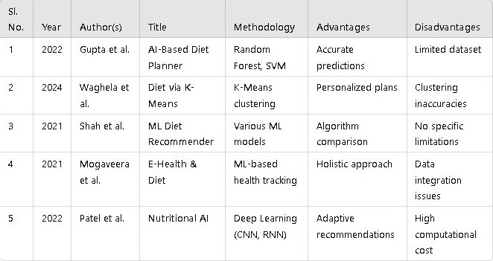
Literature Review

Slide 5
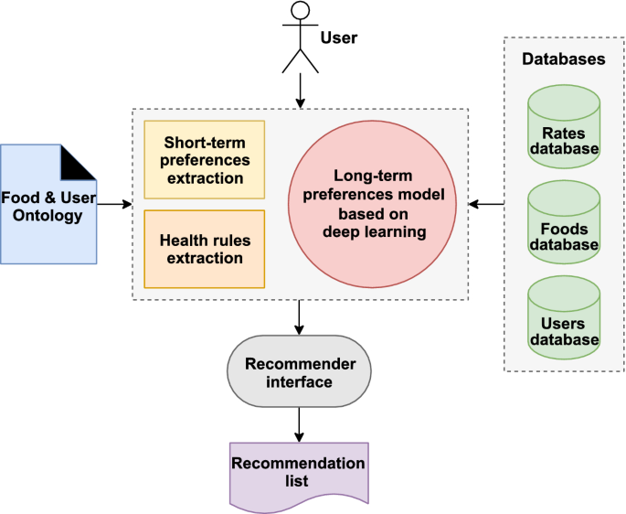
Module Design
Brief overview of the project’s modular architecture
The diet recommender system follows a modular architecture for scalability, efficiency, and flexibility. Each module handles specific tasks like data preprocessing, model training, and recommendation generation, ensuring real-time personalized diet suggestions.

Slide 6
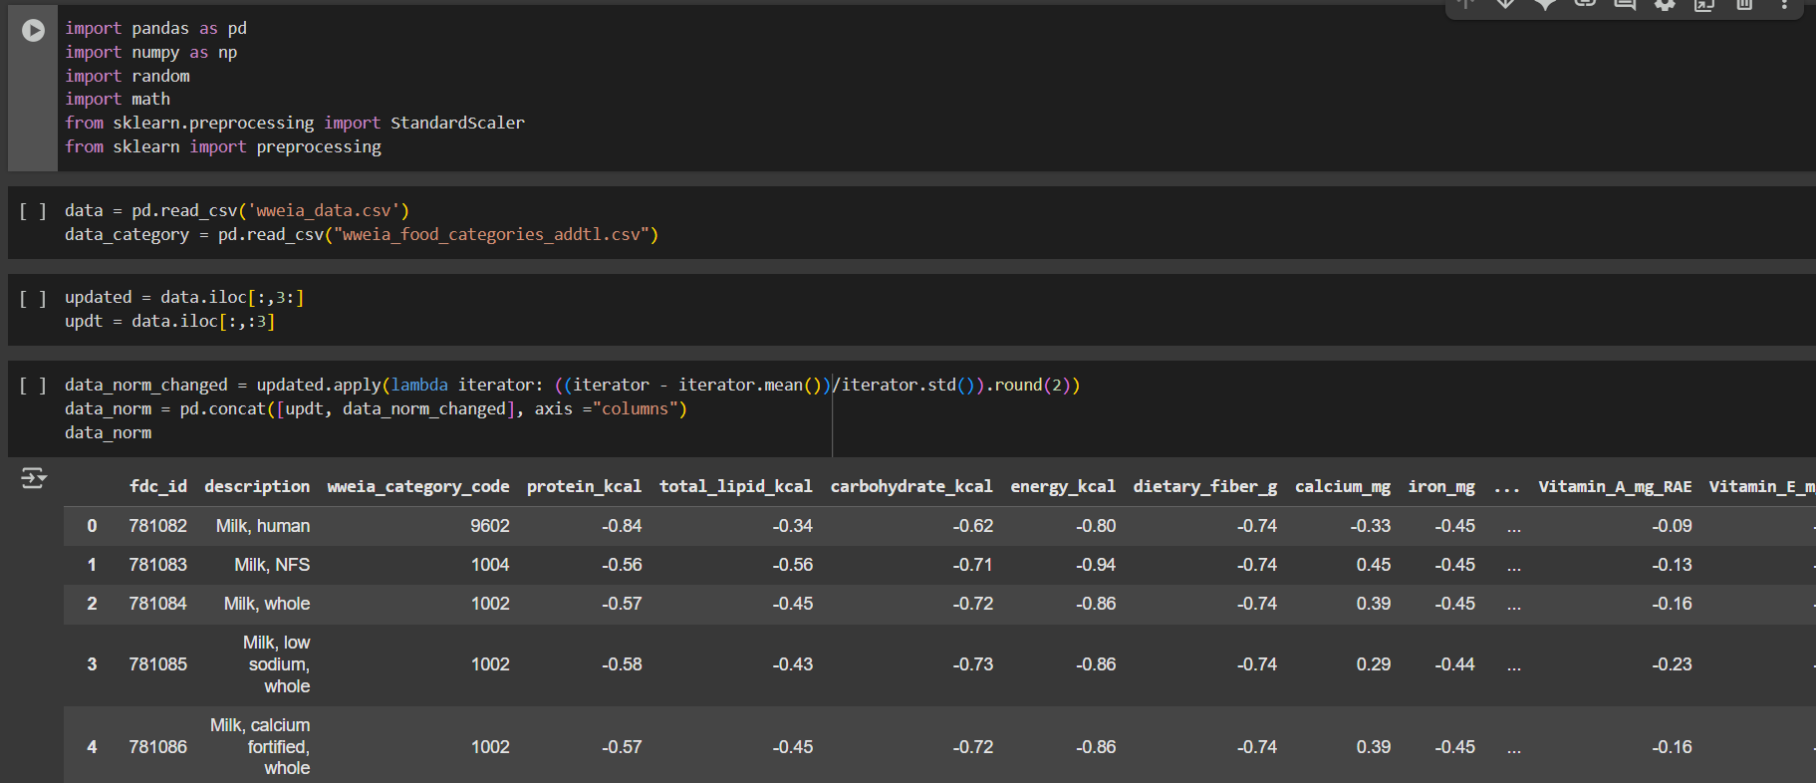
Modular Breakdown
Module 1: Data Ingestion and Preprocessing
7

Slide 7
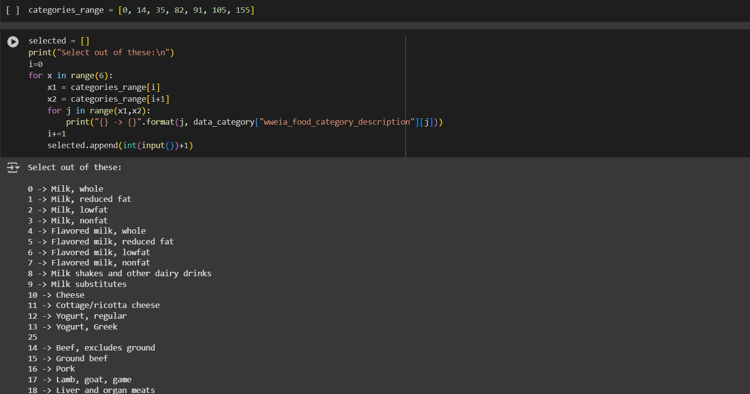
Module 2: Feature Engineering & Selection

Slide 8
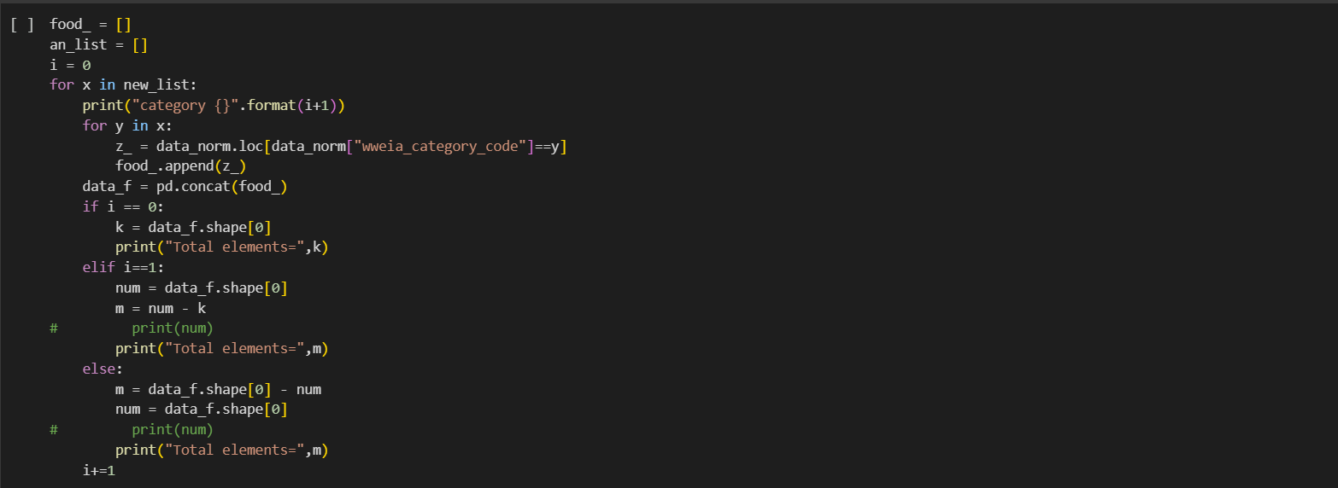
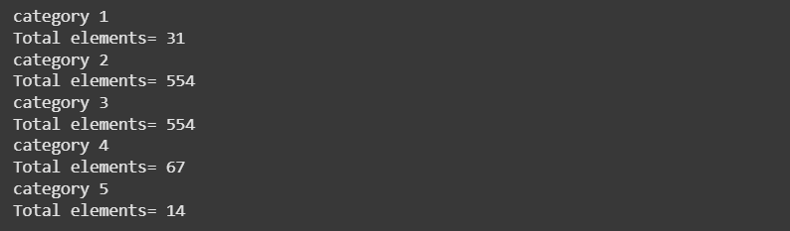
Module 3: Machine Learning-Based Diet Recommendation
7

Slide 9
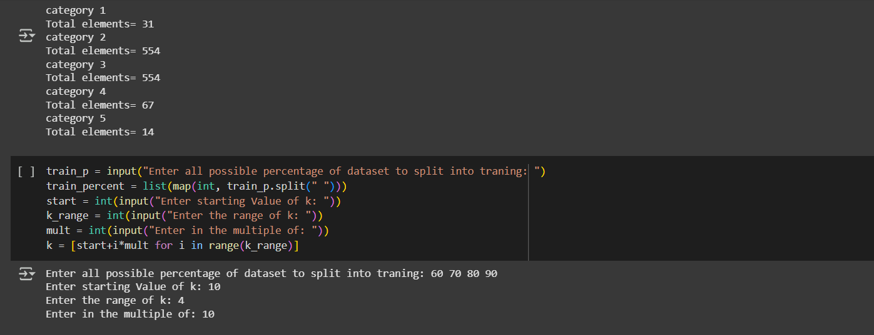

Slide 10
Module 4: Rule-Based & Behavioral Analysis
Functionality:
Implements predefined diet rules (calorie limits, dietary restrictions, meal timing).
Analyzes user eating patterns and adjusts recommendations accordingly.
Importance:
Improves user compliance by integrating behavioral insights.
Reduces recommendation errors by combining ML with expert-defined dietary rules.

Slide 11
Tools And Technologies To Be Used
1. Development Tools:
Google Colab / Jupyter Notebook – Used for coding, testing, and visualizing machine learning models for diet recommendations.
2. Programming Language:
Python – The primary language for implementing machine learning models and data analysis in the diet recommender system.
3. Frameworks & Libraries:
Pandas & Numpy – For data manipulation, analysis, and numerical computations.
Scikit-Learn – Provides efficient tools for predictive dietary analysis.
TensorFlow/Keras – Used for building and training deep learning models for personalized recommendations.
4. Additional Tools:
Matplotlib / Seaborn – For creating static, animated, and interactive visualizations of dietary patterns and nutritional insights.

Slide 12
github link
https://github.com/shivashantpatil-byte/Diet-recommender-system-using-machine-learning

Slide 13
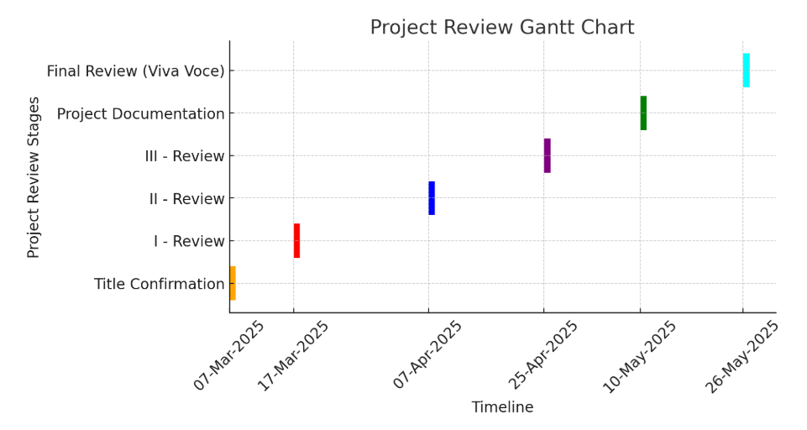
Timeline of the Project

Slide 14
References
1. Muhib Anwar Lambay, S. Pakkir Mohideen. "A Hybrid Approach Based Diet Recommendation System using ML and Big Data Analytics." B.S. Abdur Rahman Crescent Institute of Science & Technology, 2022. DOI: 10.21203/rs.3.rs-1044422/v1.
2. Megh Shah, Sheshang Degadwala, Dhairya Vyas. "Diet Recommendation System based on Different Machine Learners." International Journal of Scientific Research in Computer Science, Engineering and Information Technology, Vol. 8, Issue 3, May-June 2022. DOI: 10.32628/CSEIT228249.
3. Yuvraj Chibber, Dushyant Betala, Srividhya S. "Diet Recommendation System Using Machine Learning." International Conference on Recent Trends in Data Science and its Applications. DOI: rp-9788770040723.216.
4. D. Navya Narayana Kumari, T. Praveen Satya, B. Manikanta, A. Phani Chandana, Y. L.S. Aditya. "Personalized Diet Recommendation System Using Machine Learning." Godavari Institute of Engineering and Technology (A), 2024..

Slide 15


